Slide 1

Clonezilla
1

Slide 2
Table of contents
01
02
03
04
05
General description of Clonezilla
The main features of Clonezilla
Comparing Clonezilla features with similar tools
an example of how to use Clonezilla
Clonezilla advantages and disadvantages.
2

Slide 3
01
General description of Clonezilla
3

Slide 4
Introduction
Clonezilla is a program specifically designed for disk cloning, making it an essential tool in system development, backup, and recovery process
4
Notes:
Clonezilla is a versatile program specifically designed for disk cloning, making it an essential tool in system development, backup, and recovery processes

Slide 5
Divide the content into four ideas
Platforms
Support
Clonezilla can be used across different operating systems, including Windows, macOS, and Linux
Extensive support for various file systems, such as ext2, FAT12, and HFS+
Cost
Usability
It is an open-source software distributed under the GNU General Public License (GPL) Version 2
Clonezilla has use-case across different sectors. For instance, enterprise environment, and educational settings
5

Slide 6
02
The main features of Clonezilla
6

Slide 7
The main features of Clonezilla
01 Disk Cloning and Imaging: Clonezilla enables the creation of exact copies of entire disks or specific partitions, ideal for system restores, upgrades, or deployment.
02 Multicast Support: It offers efficient cloning of multiple machines simultaneously using multicast technology, perfect for setting up multiple computers in an organization.
03 Cloning Modes: Clonezilla provides two modes:
Device-to-device cloning for direct disk-to-disk cloning.
Device-to-image cloning, where a device is cloned to an image file for later use.
04 Bootable Media: It operates via a bootable CD/DVD or USB flash drive, allowing use without an operating system, crucial for system restoration or machines without an OS.
05 Filesystem Support: Supports a wide range of filesystems (ext2, ext3, ext4, fat16, fat32, ntfs, etc.) across various OS like Windows, macOS, and Linux.
7

Slide 8
The main features of Clonezilla
06 Differential/Incremental Backup: Compatible with differential and incremental backups using other file-based tools to minimize backup space after the initial image.
07 Compression and Encryption: Offers image compression to save space and AES-256 encryption for data security.
08 Hardware Compatibility: Works with diverse hardware, including BIOS and UEFI systems, and supports different storage devices like HDDs, SSDs, and RAID configurations.
09 Flexible Restoration: Enables image restoration to new disks or partitions, adaptable to size variations as long as the data fits.
10 Customizable Scripts: Allows advanced users to create custom scripts for task automation, beneficial for large-scale deployments.
8

Slide 9
The main features of Clonezilla
11 Network Support: Supports saving and restoring images over networks using SSH, Samba, NFS, and WebDAV.
12 Rescue Mode: Includes a rescue mode for repairing broken systems.
13 Accessibility: The interface is accessible via a Live CD, suitable for machines with limited resources.
14 Partition Table Manipulation: Capable of cloning partition tables independently, enabling exact duplication of partition layouts.
highlight Clonezilla's flexibility, making it a reliable solution for system backup, deployment, and recovery for both individual and enterprise users. Its versatility and powerful cloning capabilities, coupled with the advantage of being free, make it a favored choice among IT professionals.
9

Slide 10
03
Comparing Clonezilla features with similar tools.
10

Slide 11
Clonezilla vs. Acronis True Image:
Clonezilla: Open-source tool.
Acronis True Image: Commercial with a free trial.
Acronis: More user-friendly GUI, diverse backup options.
Clonezilla vs. Duplicati:
Clonezilla: Focus on disk images, complete system backups.
Duplicati: Prioritizes file backups with encryption and deduplication.
Clonezilla: Emphasizes complete system backup, while Duplicati offers versatile backup destinations
11

Slide 12
Clonezilla vs. Macrium Reflect:
Macrium Reflect: Commercial with free edition.
Macrium: Faster backup, user-friendly.
Clonezilla: Advanced users, complete disk images.
Clonezilla vs. Amanda Network Backup:
Clonezilla: Local backup tool.
Amanda Network Backup: Network-based, for enterprises.
Clonezilla: Individual system backups.
12

Slide 13
04
An example of how to use Clonezilla
13

Slide 14
Clonezilla for Hard Disk Cloning
Step 1: Download Clonezilla from the official website
Step 2: Make sure the version you plan to download is compatible with your system and stable.
Step 3: To backup your data, you must connect both the external disk and the bootable device containing Clonezilla. When you're sure they've been fitted correctly, please restart the system.
14

Slide 15
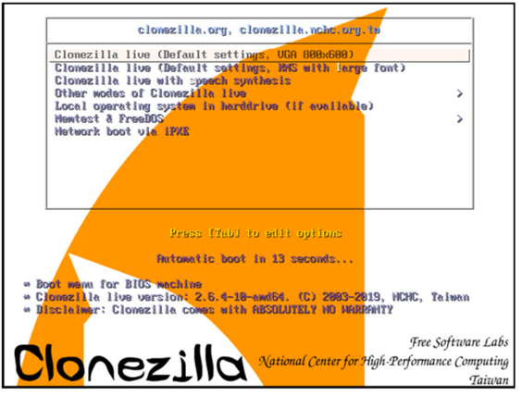
Clonezilla for Hard Disk Cloning
Step 4: Clonezilla welcome screen. Select the option Clonezilla live option and press enter to continue.
15

Slide 16
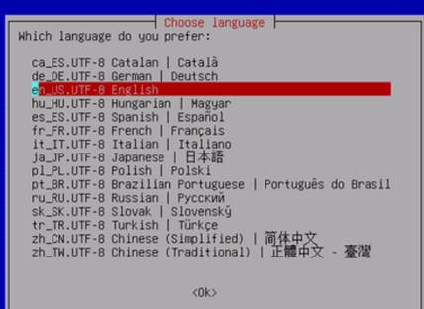
Clonezilla for Hard Disk Cloning
Step5: The language screen will then show up. Here, you must choose the language that is appropriate for the cloning procedure.
16

Slide 17
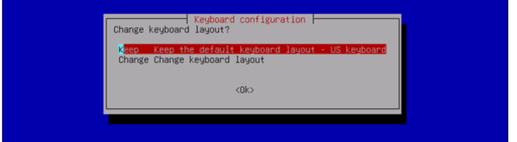
Clonezilla for Hard Disk Cloning
Step 6: You have the ability to customize or alter your keyboard layout in the following step.
First is the US keyboard layout that is used by default.
Second is the keyboard layout changing option.
17

Slide 18
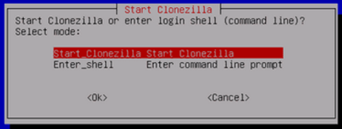
Clonezilla for Hard Disk Cloning
Step 7: The start screen then shows up, giving you the choice to launch Clonezilla or dive right in and start interacting with the shell. In order to continue, we choose the option Start Clonezilla and hit Enter.
18

Slide 19
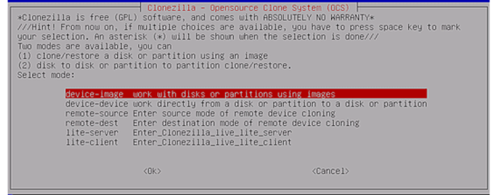
Clonezilla for Hard Disk Cloning
Step 8: Selecting the device-image alternative and pressing Enter will allow us to clone a local encrypted disk image. The resulting image of the cloned hard disk will be saved on a network space for this example.
19

Slide 20
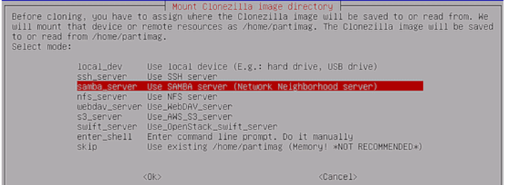
Clonezilla for Hard Disk Cloning
Step 9: The cloned image will be saved on the network shared directory using the CIFS/SMB protocols. To store the cloned picture, you are also free to utilize other widely used network protocols.
We will choose samba_server from this interface and press the Enter key to proceed.
20

Slide 21
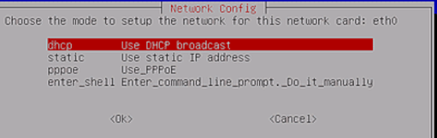
Clonezilla for Hard Disk Cloning
Step 10: When configuring the network interface,Select the DHCP network's physically linked interface.
21

Slide 22
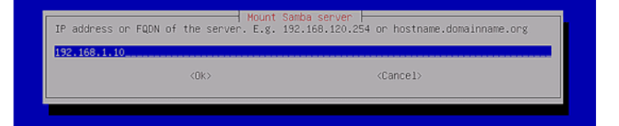
Clonezilla for Hard Disk Cloning
Step 11: At this point, the Samba server's IP address is added.
Next, press Enter to move on to the next screen.
22

Slide 23
Clonezilla for Hard Disk Cloning
Step 12: Leave the domain box empty if there isn't a recognized domain established on your Samba server. However, if it has, please note so in the designated space as shown in the image below. Next, click "enter" to continue.
23

Slide 24
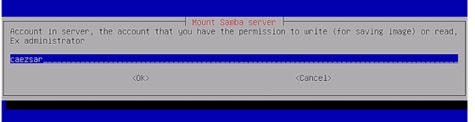
Clonezilla for Hard Disk Cloning
Step 13: Add a Samba server account name.
24

Slide 25
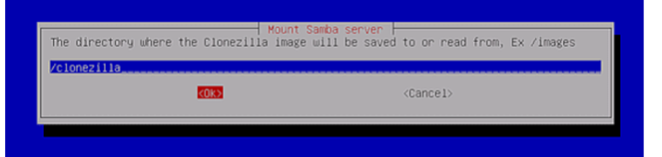
Clonezilla for Hard Disk Cloning
Step 14: Give the directory's absolute path from the Samba server.
25

Slide 26
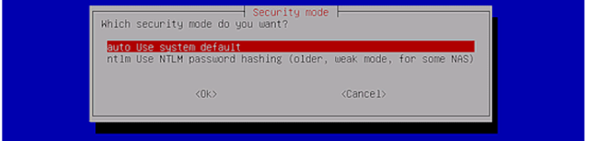
Clonezilla for Hard Disk Cloning
Step 15: Choose the updated Samba protocol version.
And hit "enter" to go on to the next prompt.
Use protocol version 1.0 if the shared network location is hosted by an outdated SMB server.
26

Slide 27
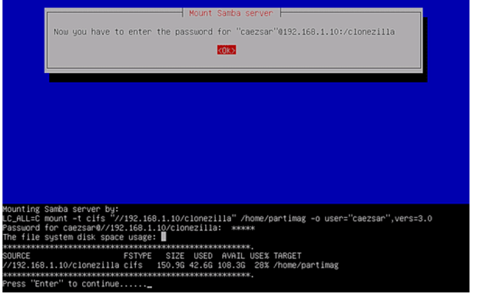
Clonezilla for Hard Disk Cloning
Step 17: At this point, your Samba account has to have a password added. This comes before mounting the share and moving forward by hitting the "enter" key.
27

Slide 28
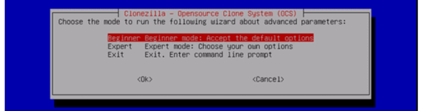
Clonezilla for Hard Disk Cloning
Step 18: The user is given the option to choose the wizard's operating mode in the subsequent interface. You can choose between basic and expert options.
28

Slide 29
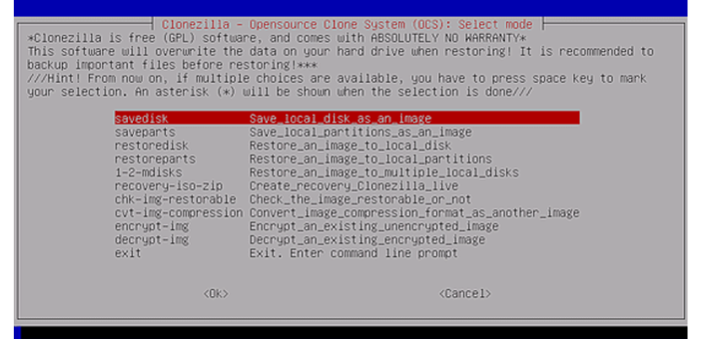
Clonezilla for Hard Disk Cloning
Step 19: To image the locally attached IDE/SCI/SATA drive, select the savedisk choice.
29

Slide 30
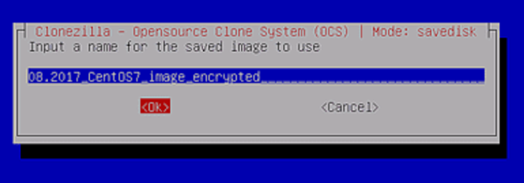
Clonezilla for Hard Disk Cloning
Step 20: You may either manually add a descriptive name to your stored image or keep the default naming scheme that Clonezilla adds for you.
30

Slide 31
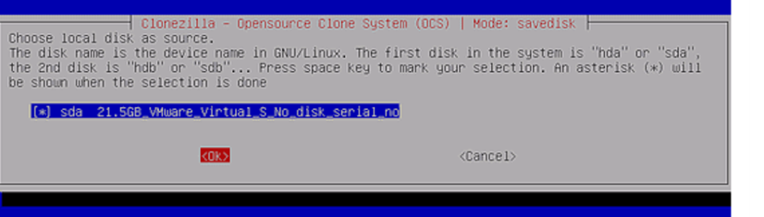
Clonezilla for Hard Disk Cloning
Step 21: Select which local source disk you want to copy over.
It is important to pay attention to the names used
while choosing the source disk, since they may be unfamiliar to you.
31

Slide 32
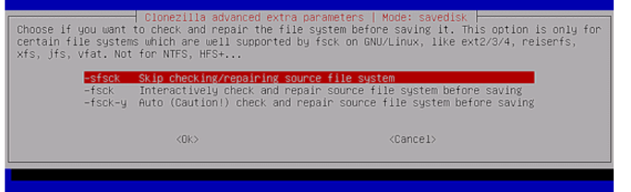
Clonezilla for Hard Disk Cloning
Step 22: If you are positive that the source file system is not corrupted, choose "Skip checking/repairing source file system" and hit the enter key to continue.
32

Slide 33
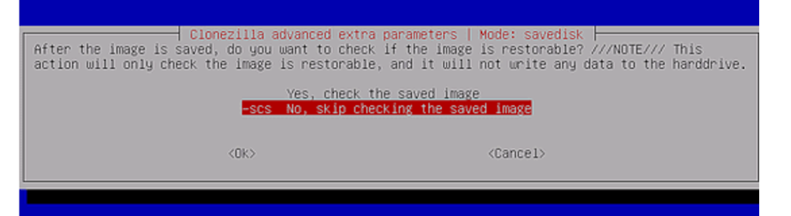
Clonezilla for Hard Disk Cloning
Step 23: Select "no" on this screen. This will guarantee that there will be no need to inspect the stored image. Next, choose OK to proceed
33

Slide 34
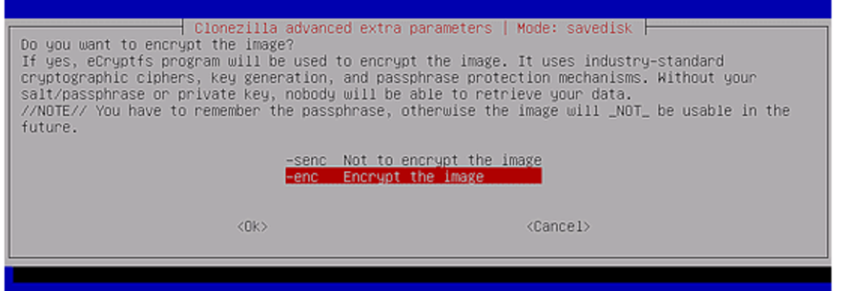
Clonezilla for Hard Disk Cloning
Step 24: Select the encryption of the picture as the second option here.
To proceed, choose OK and then hit "enter." Consequently, the cloned image that is produced is encrypted using the eCryptfs application.
34

Slide 35
Clonezilla for Hard Disk Cloning
Step 25: The cloning process is taken over by Clonezilla. If you choose to proceed with the procedure, it first displays a report of the activity that is taking place along with two cautions.
To indicate no, press n, and to indicate yes, press y.
35

Slide 36
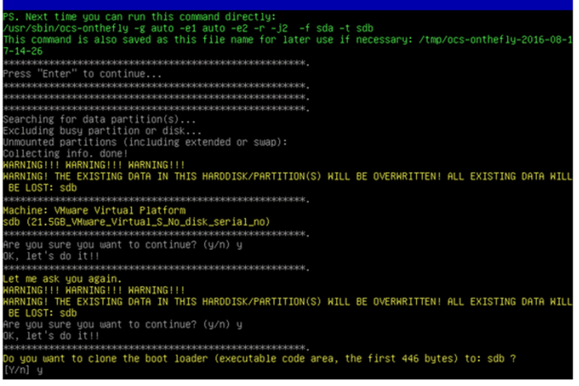
Clonezilla for Hard Disk Cloning
Following this, a choice to clone the boot loader or not is presented in the third warning.
36

Slide 37
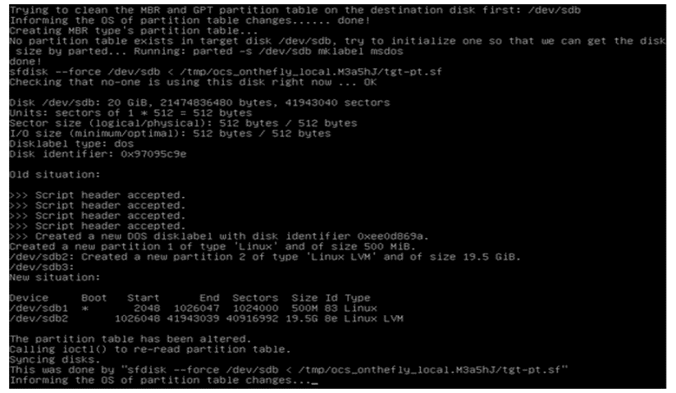
Clonezilla for Hard Disk Cloning
Step 26: When you choose to move on with the cloning, Clonezilla first creates a partition table on the target disk that you want to use.
we hit Y in order to finish the cloning procedure
37

Slide 38
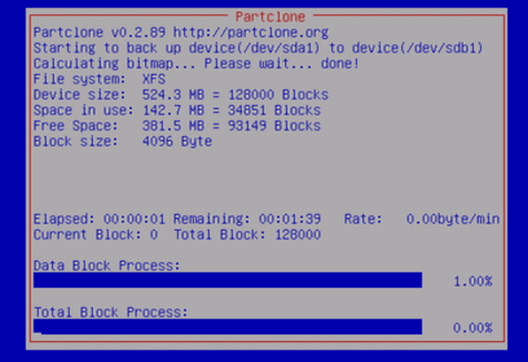
Clonezilla for Hard Disk Cloning
Step 27: This is a graphical report that shows every activity that is occurring.
38

Slide 39
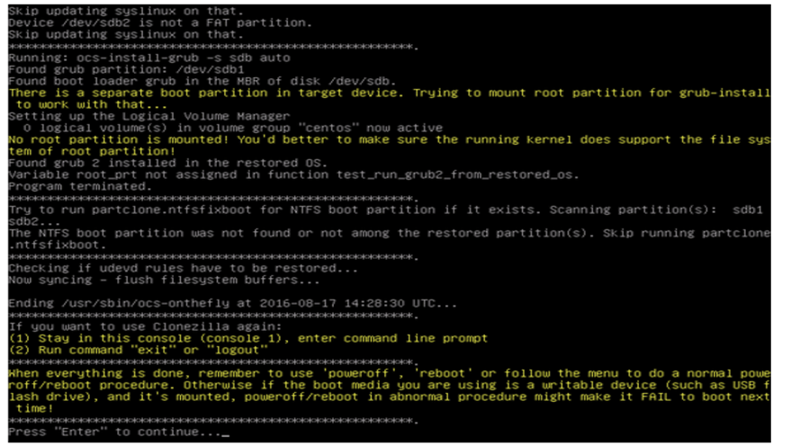
Clonezilla for Hard Disk Cloning
Step 28: After the cloning procedure is finished, a report is produced. Additionally, you are given the choice to use Clonezilla once again. selecting option 2 will launch the exit wizard; selecting option 1 will keep you in console mode. As an alternative, use "enter" to bring up the exit screen.
39

Slide 40
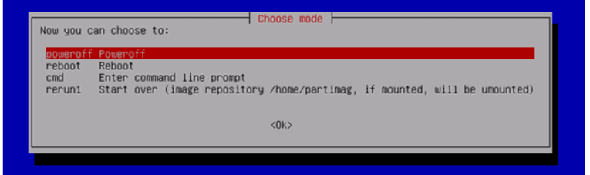
Clonezilla for Hard Disk Cloning
Step 29: There are four options on the screen that appears next.
These consist of:
- "Poweroff" to halt.
- "reboot" to resume.
- "cmd" to launch the interactive command-line interface.
- "rerun1" to start the cloning operation over.
40

Slide 41
Clonezilla for Hard Disk Cloning
The disk drive copying process is now complete !!
At this point, your only options are to disconnect your external drive, store it somewhere secure, swap out your existing disk, and boot your computer using the new disk.
41

Slide 42
05
Clonezilla advantages and disadvantages.
42

Slide 43
Advantages of Clonezilla:
Free and Open-Source
Cross-Platform Support
Disk Imaging
which means it's free to use and can be customized or modified to suit your needs.
It is compatible with Windows, macOS, and Linux.
Clonezilla can create complete disk images, including the operating system, applications, and data, providing a comprehensive backup solution.
Disk Cloning
Support for Various File Systems
Multicast Support
It allows for easy disk cloning, enabling users to replicate the entire contents of one drive to another.
Clonezilla supports a wide range of file systems, making it compatible with different storage devices and operating systems.
It can deploy disk images to multiple computers simultaneously over a network using multicast.
43

Slide 44
Disadvantages of Clonezilla:
Complex for Beginners
No Real-Time Backups
Limited Incremental Backup Support
The text-based interface can be intimidating for novice users. Creating and restoring disk images with Clonezilla may require a learning curve.
It does not provide real-time or continuous backup solutions.
it may not be as feature-rich or user-friendly as dedicated incremental backup tools.
No File-Level Backups
Lack of Graphical User Interface
No Real-Time Synchronization
Clonezilla operates at the disk or partition level and does not provide the ability to back up individual files or folders.
Clonezilla's interface is text-based, which can make it less appealing to users who prefer graphical user interfaces.
Clonezilla is not designed for real-time data synchronization between devices, so it may not be suitable for scenarios where continuous data updates are critical .
44

Slide 45
Thanks!
ID | Name
442002988 | Monerah Almobarak
442005420 | Alaa Alshuaibi
442000786 | Sarah Altaweel
442005104 | Sarah Aljuhani
442003374 | Nada Alotaibi
45

